Slide 1
Midterm Python Revision
VinAC

Slide 2
01
Values, types and operators

Slide 3
Definition
An expression evaluates to a value.
A type is a set of values plus the operations allowed on them: int, float, str, bool.
Ex:
2 # int literal
3 # int literal
2 + 3 # evaluates to 5

Slide 4
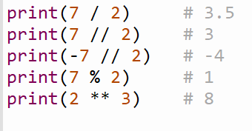
Operators
** is the power
% is the remainder
// is floor division (rounds toward negative infinity)
/ always returns a float
Precedence(high to low):
(), **, unary + -, * / // %, + -, comparisons / is / in, not, and, or.

Slide 5
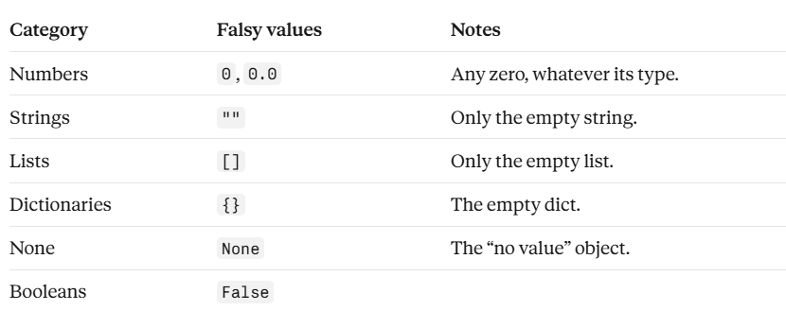
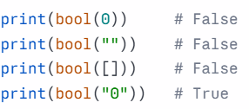
Falsy & Truthy
Falsy values:
Everything else is truthy values

Slide 6
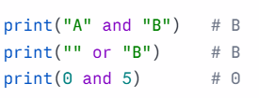
And / Or
and returns the first falsy operand (or the last operand);
or returns the first truthy operand (or the last operand).

Slide 7
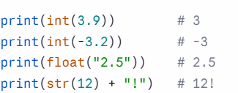
Conversion
(int(), float(), str()).
int() truncates toward zero.
input() always returns a str.

Slide 8
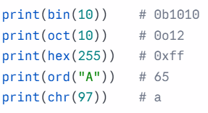
Number Systems
Convert between numbers and their representations
(Binary, Octal, Hexadecimal,Unicode)

Slide 9
02
Variables and assignment

Slide 10
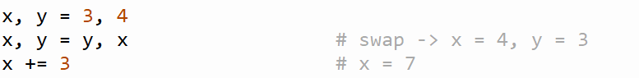
Definition
A variable is a name attached to an object; it does not contain the value.
An assignment creates the name or attaches it to a different object. It never edits the old object.
Naming rules: letters, digits, _; cannot start with a digit; case-sensitive; no keywords.
Multiple assignment and swap are allowed.
Augmented assignment: +=, -=, *=, //=, %=.

Slide 11
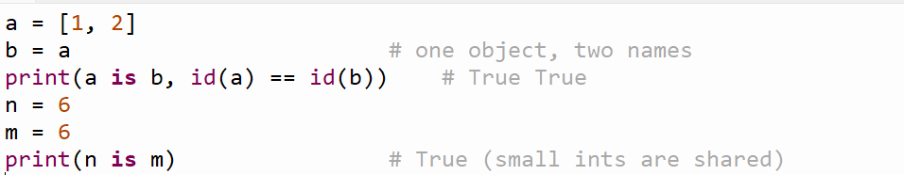
is , ==
== compares values; is compares identity (same object).
id() gives the identity.
Small integers (-5 to 256) are shared by Python (interning).

Slide 12
03
Conditionals & Loops

Slide 13
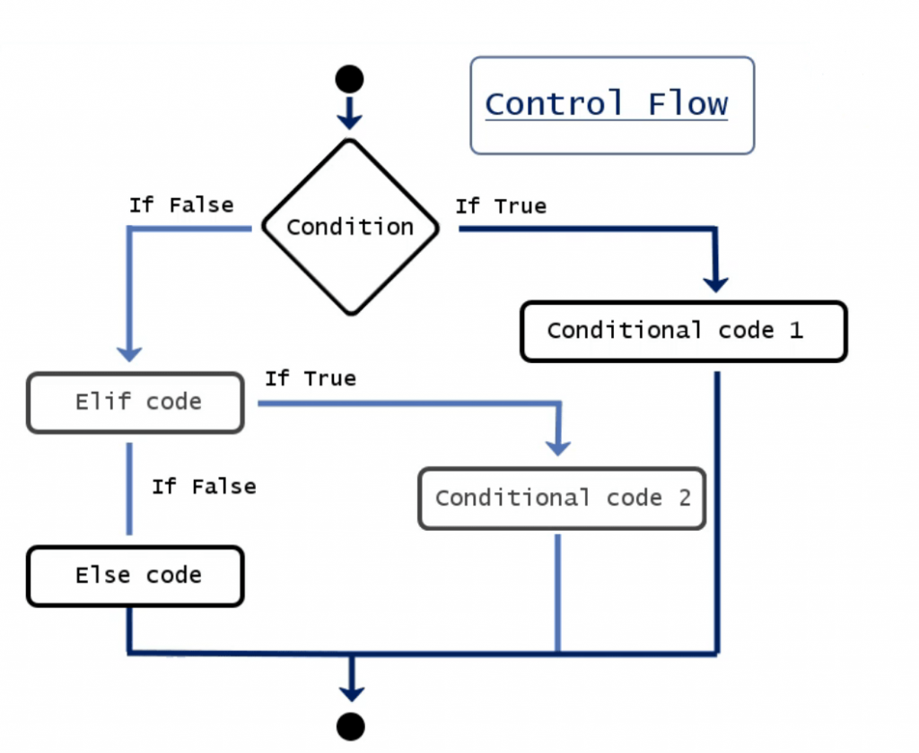
if/elif/else
if / elif / else
- Each header ends with : and the body is indented
- Only the first branch whose condition is true runs
- else has no condition and catches the rest
Writing conditions
+ Order conditions from narrow to broad
+ Use a nested if when the second test only makes sense after the first
+ Conditions are Boolean expressions: comparisons plus and, or, not
+ Comparisons can be chained: Ex 1 < x < 10
Common mistake
== compares; = assigns
Using = inside an if causes a SyntaxError

Slide 14
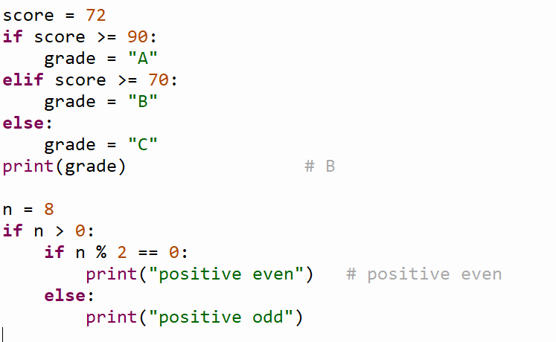
Example

Slide 15
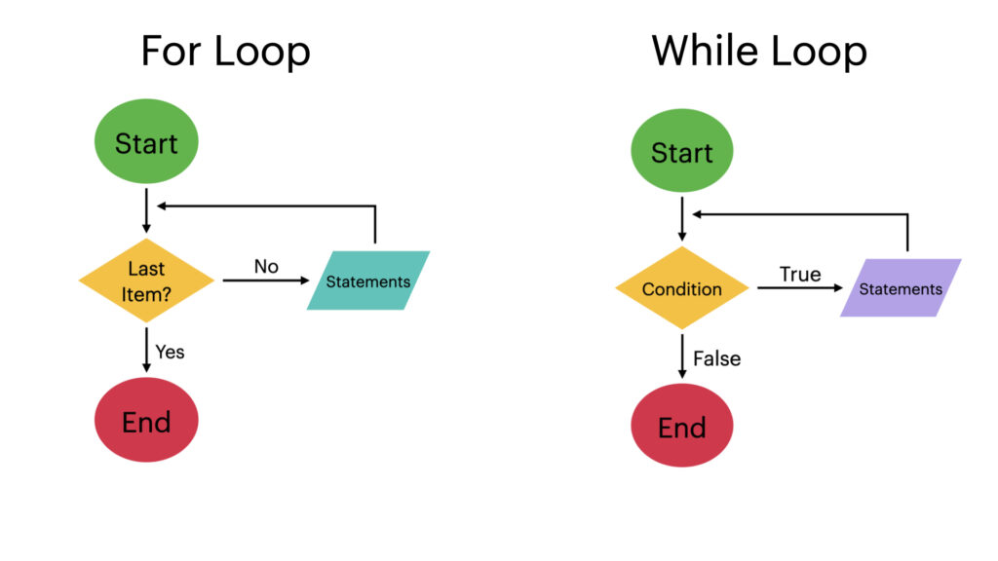
Loops
for loop & While loop
1. for x in sequence: runs the body once for each item
range(start, stop, step) produces numbers
stop is not included
2. while condition: repeats as long as the condition is true
Something in the body must eventually make it false
Controlling a loop
break leaves the loop
continue skips to the next iteration
else
Runs only when the loop ended without break
For a while loop, it also runs if the condition was false from the start
Loop invariant
A statement about the variables that is true before the loop and after every iteration
Helps prove the loop is correct

Slide 16
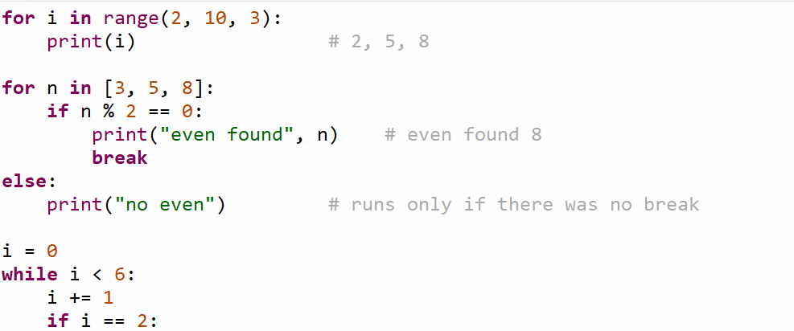
Example

Slide 17
04
Functions

Slide 18
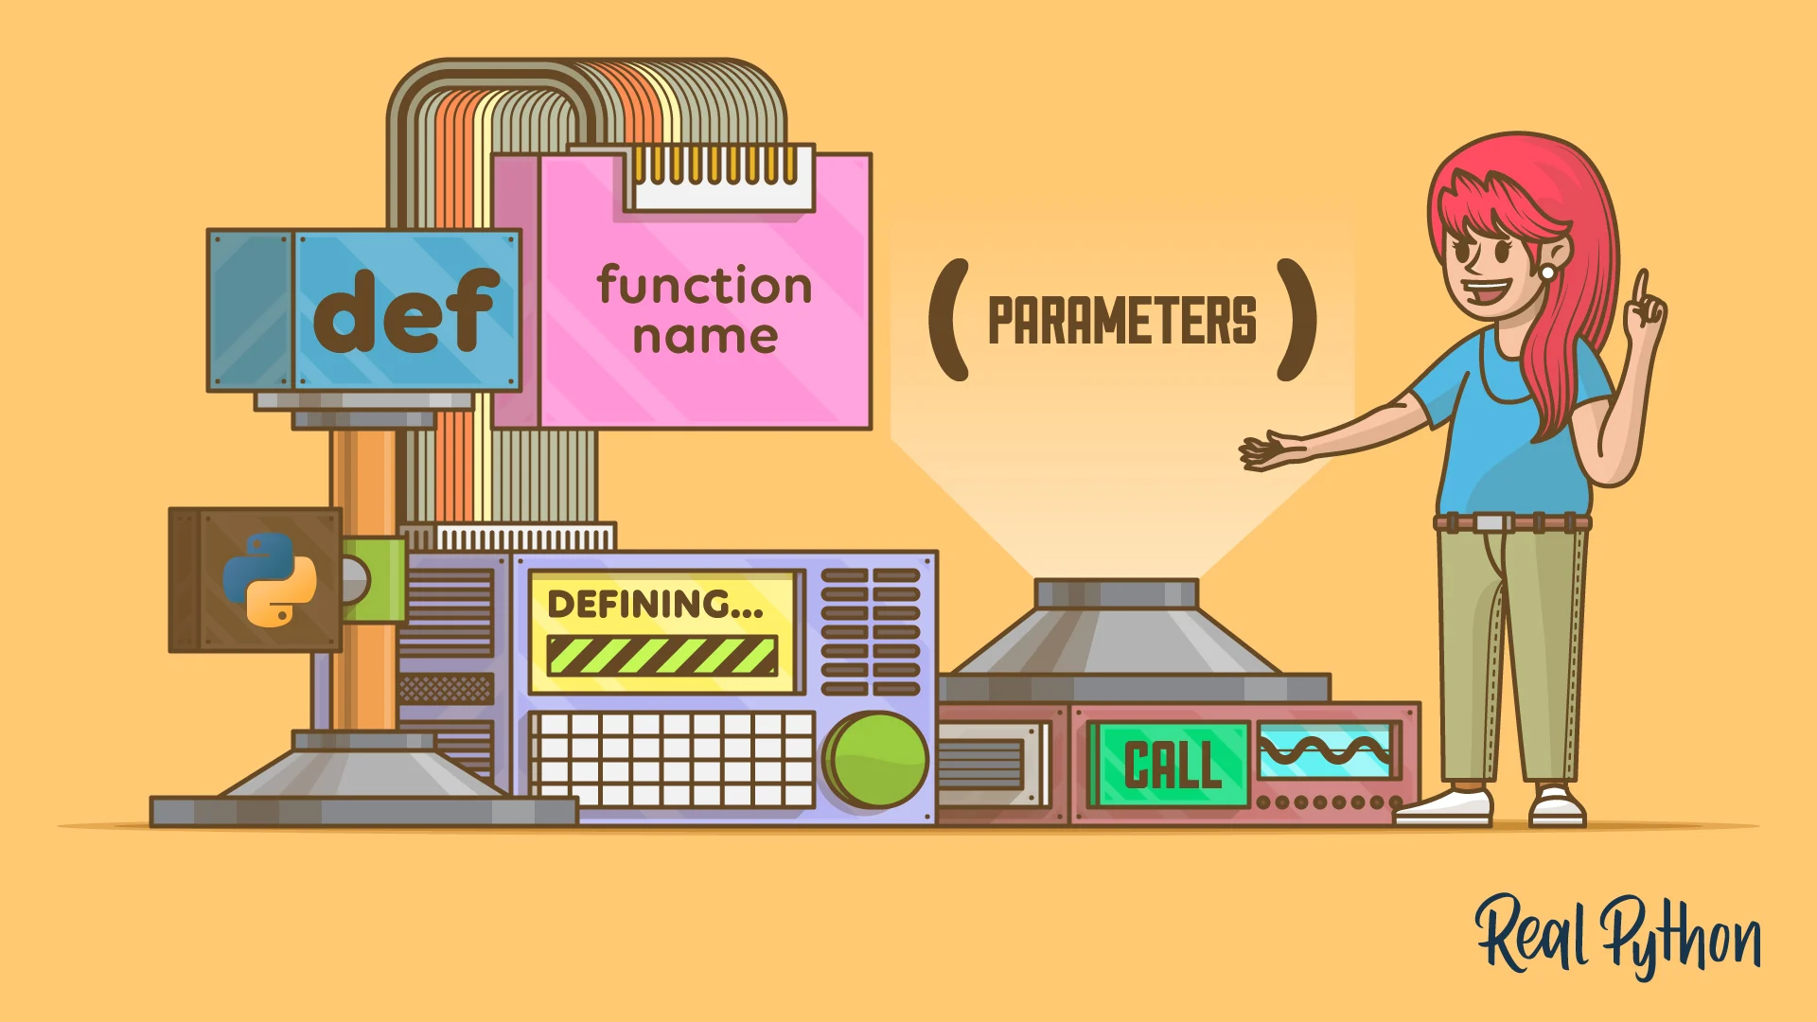
Definition
Defining a function
Syntax: def name(parameters): then an indented body
A parameter is the name in the definition
An argument is the value passed in the call
Defining a function does not run its body; the body runs only when the function is called
Default parameters must come after parameters without defaults
return: sends a value back and ends the function
With no return, the result is None
print shows text on screen; return gives a value back to the caller

Slide 19
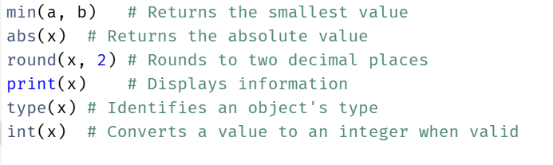
Built-in functions

Slide 20
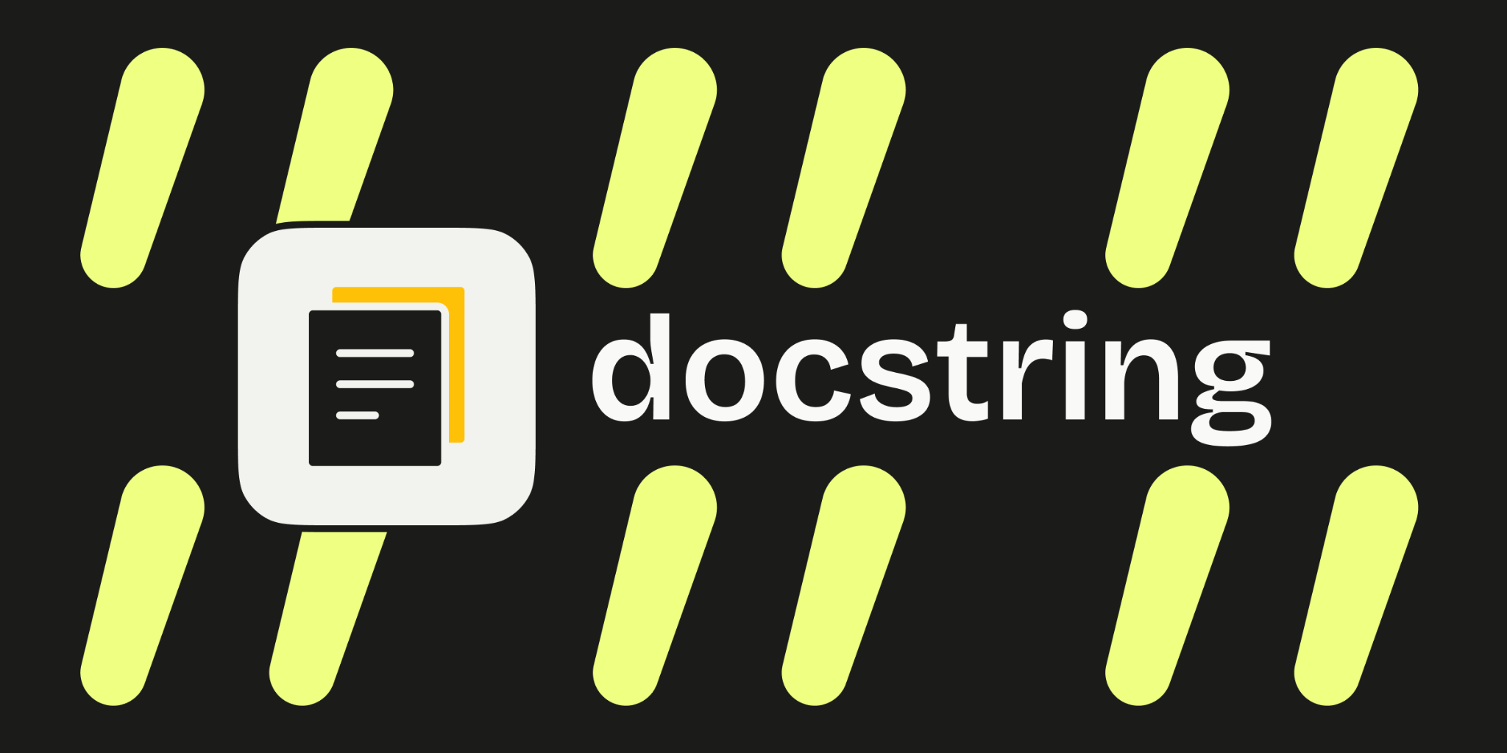
Docstring & Formatting
Docstring
The function’s specification
Includes: description, parameters, return value and precondition
Formatting
"{}".format(...) inserts values into a string
{:.2f} gives two decimals
{:,} adds thousands separators

Slide 21
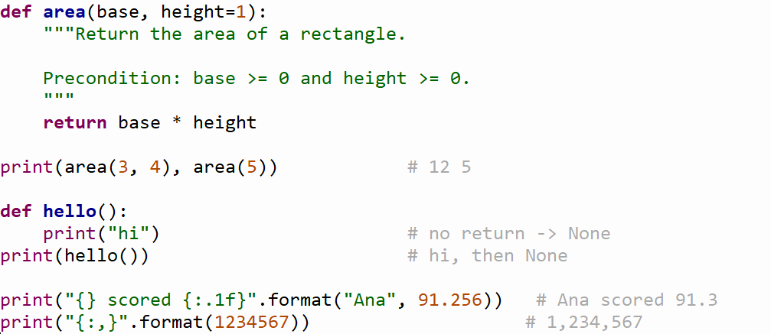
Example

Slide 22
05
Call frames and scope

Slide 23
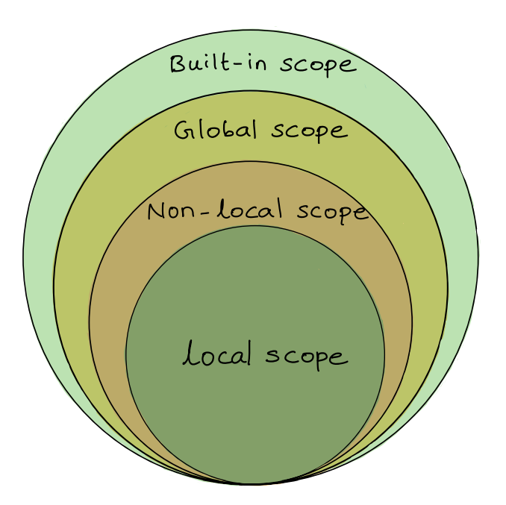
Definition
Each call creates a call frame holding the parameters and local variables. The frame is deleted when the call returns.
Build the frame → Run the body → Delete the frame
Global | Nonlocal | Local
Defined outside all functions; change it with global x | Variable of the enclosing function; changed from a nested function with nonlocal x | Defined inside a function; exists only during that call

Slide 24
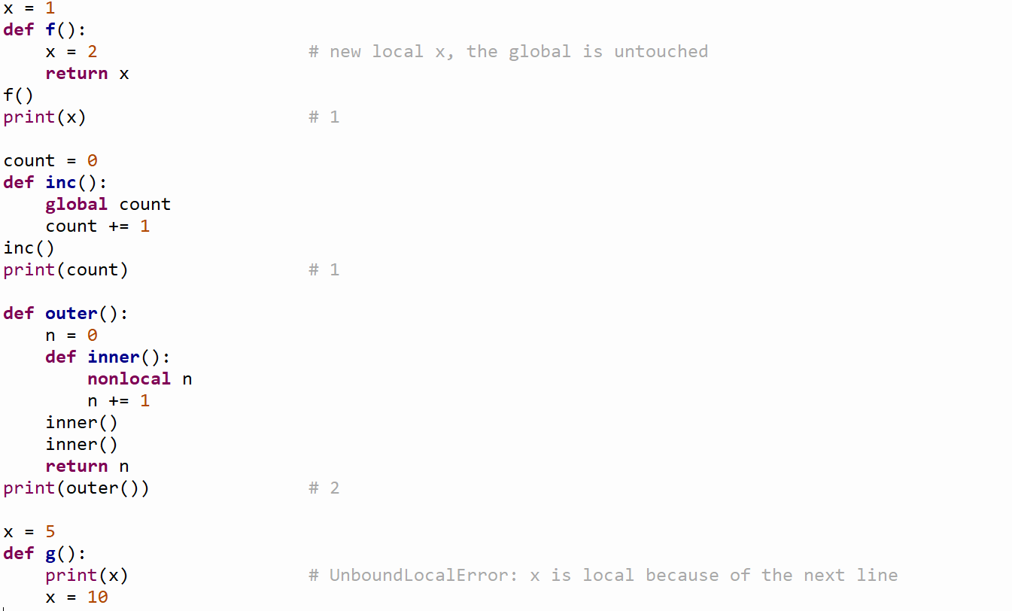

Slide 25
06
Modules

Slide 26
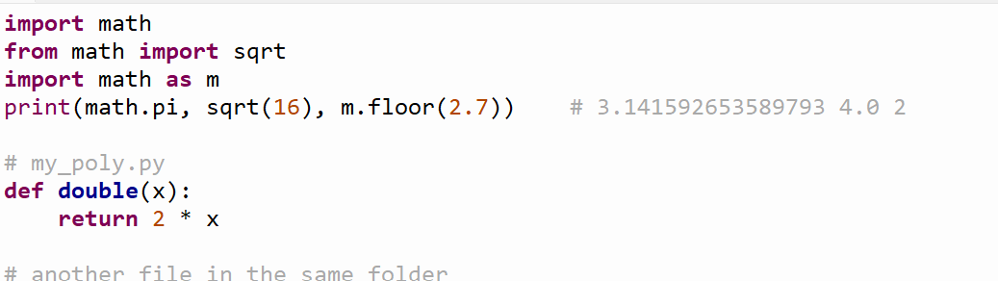
Definition
A module is a .py file with definitions and statements. It has its own global namespace.
Forms: import math, from math import sqrt, import math as m, from math import * (imports every name and can overwrite yours).
help(module) shows the documentation. Standard library: math, os, random. External libraries are installed with pip.
To use your own module, save the file and open Python in the same folder. Import it without .py.

Slide 27
07
Strings

Slide 28
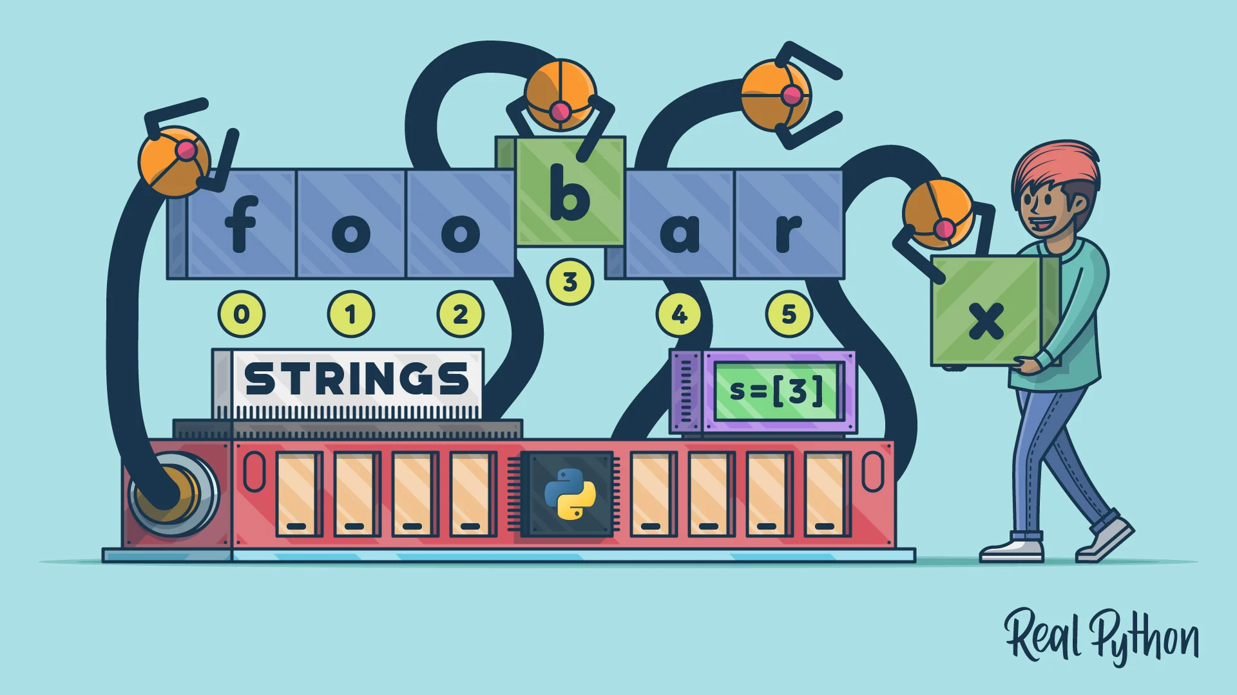
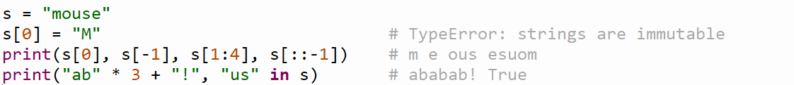
Definition
A string is an ordered sequence of characters.
Properties:
Immutable: can’t be changed after creation.
Indexed:
Indexes start at 0; negative indexes count from the end (-1 is the last). One index out of range raises IndexError.
Slice [start:stop:step]: stop is excluded; a negative step goes backward; slicing out of range does not raise an error. A slice makes a new string.
Operators: + (join), * (repeat), in (substring test), ==, is.

Slide 29
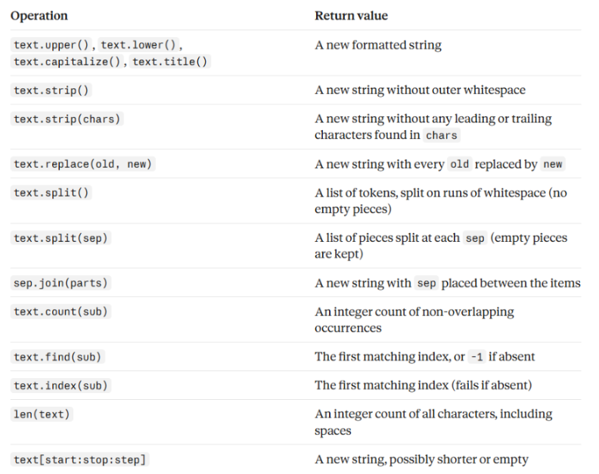
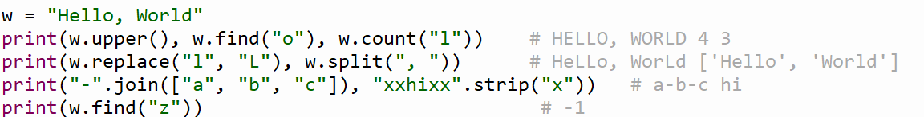
Strings Methods
Examples:

Slide 30
08
Lists

Slide 31
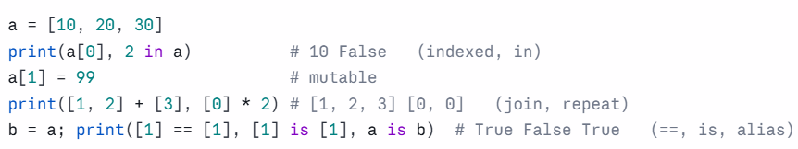
Definition
Lists: An ordered, mutable sequence of references, written with []. Can hold any objects, including other lists.
Properties:
+ Indexed
+ Mutable
+ Operators: + (join), * (repeat), in (substring test), ==, is.
+ Alias: b = a makes a second name for the same list (not a copy), so changing it through one name shows up in the other.

Slide 32
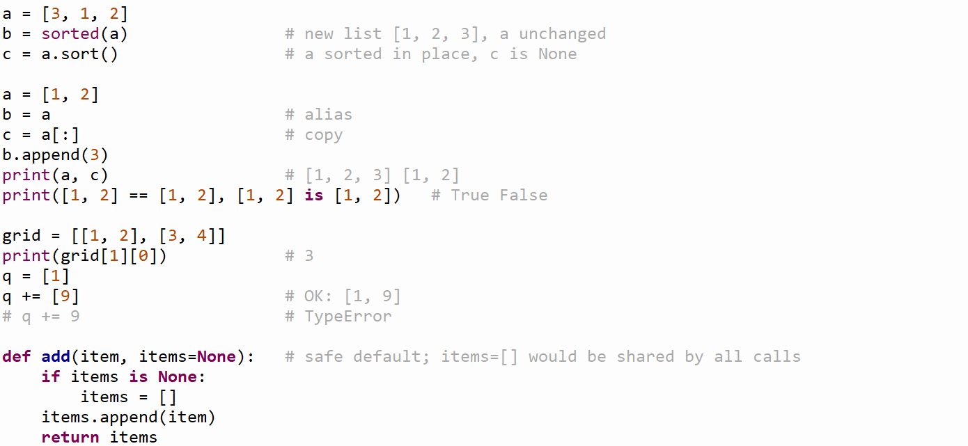
Example 2

Slide 33
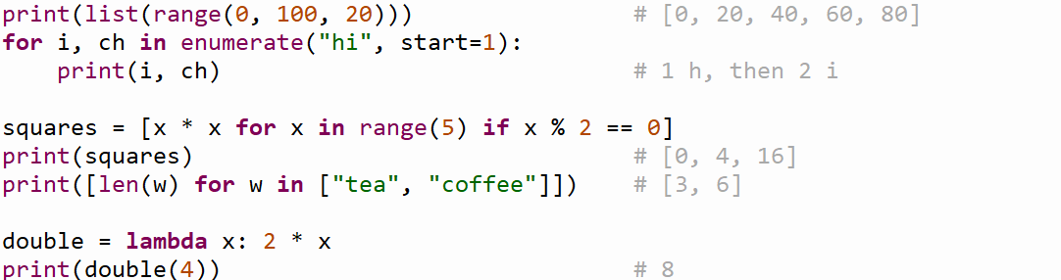
Iterating, enumerate and comprehensions
Loop over any sequence with for range gives numbers:
Ex: range(5) is 0,1,2,3,4.
enumerate(iterable, start=0) yields (index, value) pairs.
A list comprehension builds a new list: [expression for x in iterable if condition]. It does not change the original sequence.
lambda creates a small one-line function without a name.

Slide 34
09
Memory model

Slide 35
Definition
Global space: holds global variables
Heap space: holds objects (lists, modules, functions, custom objects)
A variable stores the id that points to its object
Call stack: holds the call frames of active function calls
Too many frames cause a stack overflow (e.g. recursion with no stopping condition)
Examples
import math -> global variable math points to a module object on the heap
def f -> global variable f points to a function object on the heap
Shared objects
A parameter and the caller's variable refer to the same object, so changing it inside the function changes it outside
Freeing memory
Python frees memory automatically using reference counting and a garbage collector
An object is deleted when its count reaches 0
sys.getrefcount(x) reads one higher than expected because the call adds a temporary reference

Slide 36
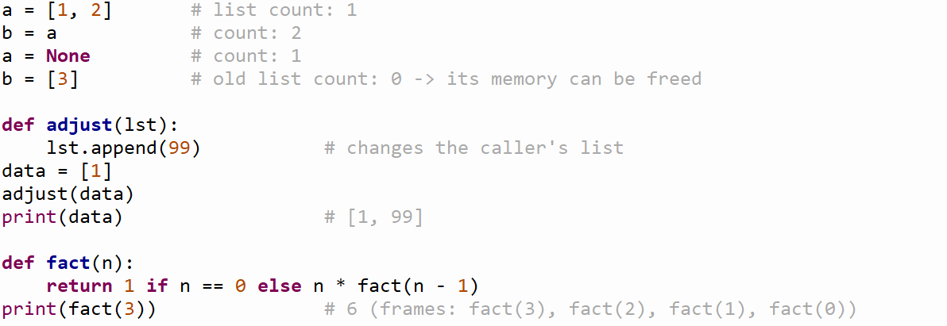
Example

Slide 37
10
Specification, errors, testing and exceptions

Slide 38
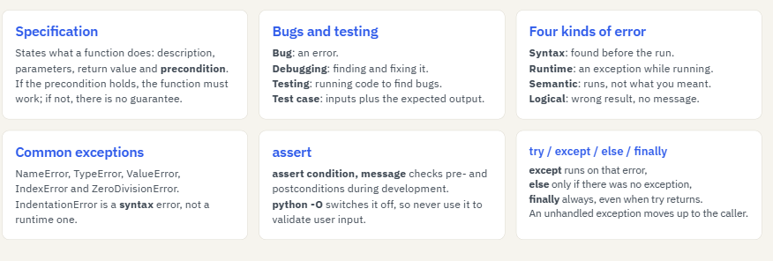
Definition

Slide 39


